Slide 1
Self-contradictory hallucinations of llms: evaluation, detection & mitigation
Department of Computer Science
ETH Zurich, Switzerland
Dongzhuyuan Lu
Niels Mündler, Jingxuan He, Slobodan Jenko, and Martin Vechev. Self-contradictory hallucinations of LLMs: Evaluation, detection and mitigation. In ICLR, 2024. URL https://openreview.net/forum?id=EmQSOi1X2f

Slide 2
overview
The paper presents a comprehensive investigation into self-contradiction for various instruction-tuned LLMs.
The primary evaluation task is open-domain text generation, but it is transferable to question answering.
The work proposes a novel prompting-based framework to detect and mitigate self-contradictions.
The framework applies to black-box LMs.

Slide 3
Background
Self-contradiction:
an LM generate two logically inconsistent sentences given the same context.
two contradicting sentences cannot be simultaneously correct
inconsistency can be detected and removed by logical reasoning

Slide 4
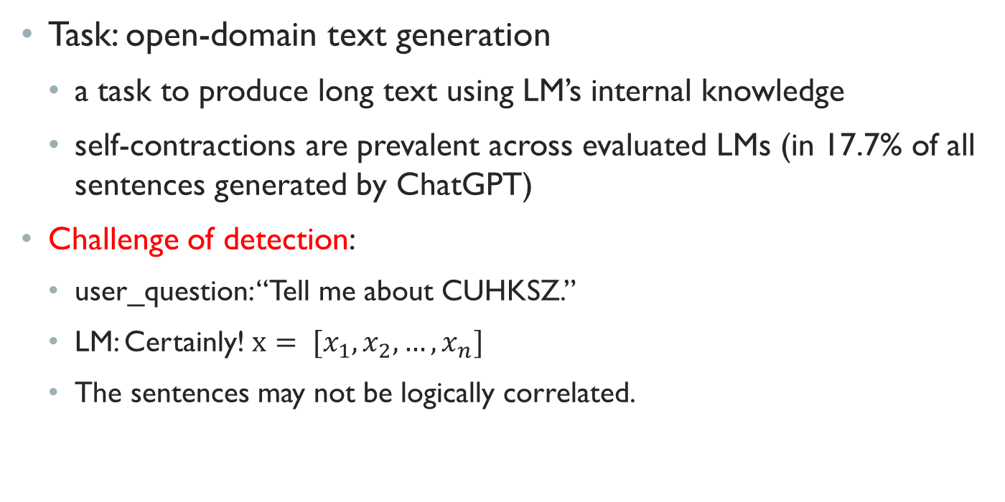
background
Task: open-domain text generation
a task to produce long text using LM’s internal knowledge
self-contractions are prevalent across evaluated LMs (in 17.7% of all sentences generated by ChatGPT)
Challenge of detection:
user_question: “Tell me about CUHKSZ.”
LM: Certainly! $x= [x_{1},x_{2},…,x_{n}]$
The sentences may not be logically correlated.

Slide 5
Defining the problem
Self-contradiction
A pair of sentences (x, x’) generated by an LM
They must describe the same subject
Their generation needs to be constrained by some context c
Non-factuality:
When x and x’ contradict each other, at least one of them is factually incorrect (or both).

Slide 6
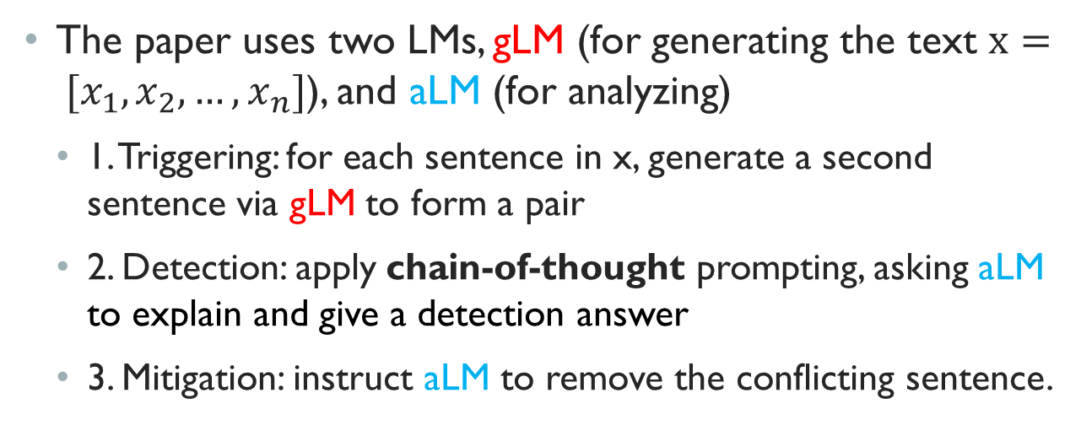
Designing the framework
The paper uses two LMs, gLM (for generating the text $x= [x_{1},x_{2},…,x_{n}]$), and aLM (for analyzing)
1. Triggering: for each sentence in x, generate a second sentence via gLM to form a pair
2. Detection: apply chain-of-thought prompting, asking aLM to explain and give a detection answer
3. Mitigation: instruct aLM to remove the conflicting sentence.

Slide 7
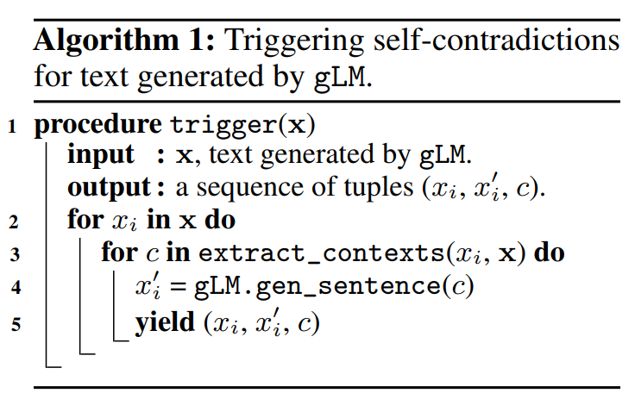
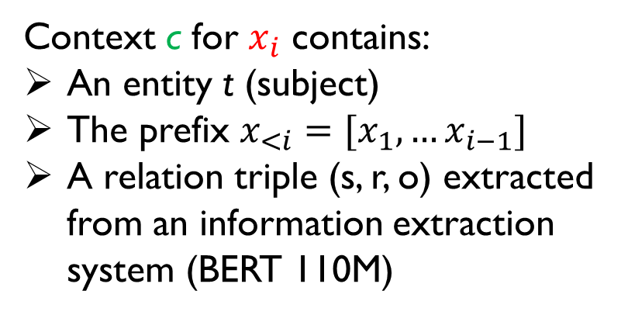
Triggering
Context c for $x_{i}$ contains:
An entity t (subject)
The prefix $x_{<i}=[x_{1},…x_{i−1}]$
A relation triple (s, r, o) extracted from an information extraction system (BERT 110M)

Slide 8
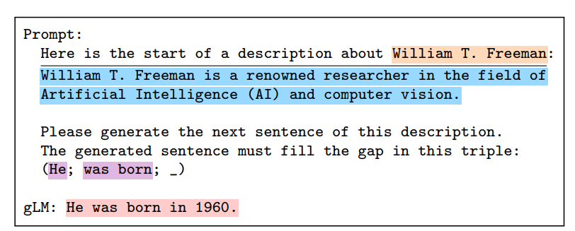
Triggering
entity
prefix
gLM.gen_sentence(c)
relation triple

Slide 9
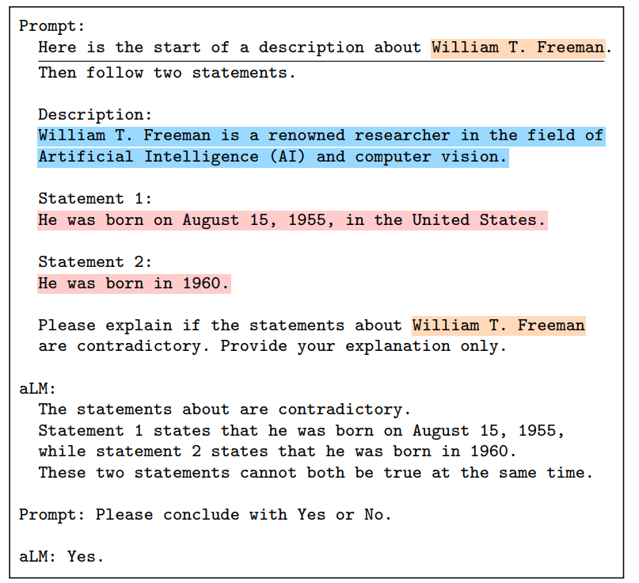
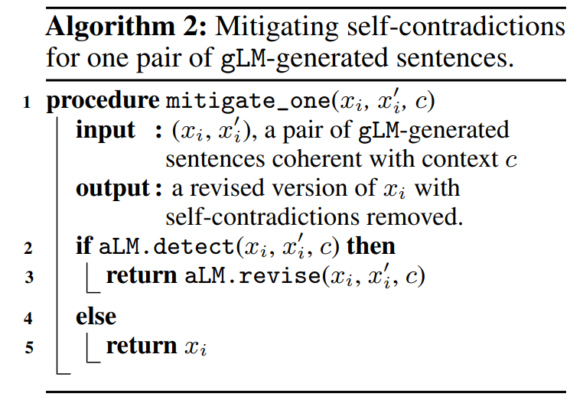

Detection & Mitigation
aLM.detect($x_{i}, x_{i}^{′}, c$)

Slide 10
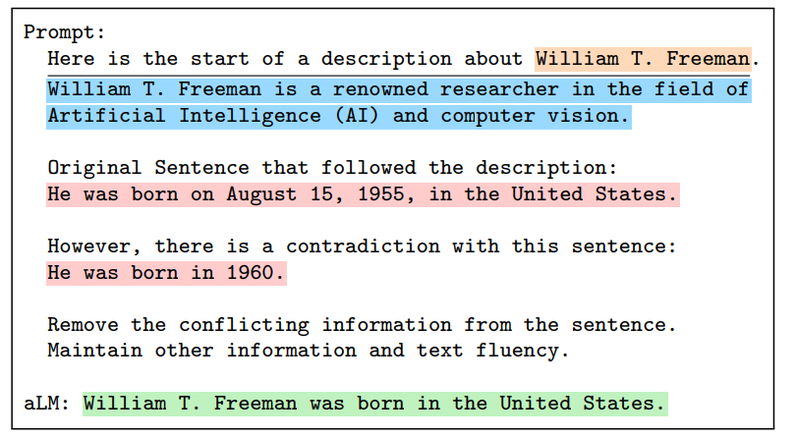

Detection & Mitigation
aLM.revise($x_{i}, x_{i}^{′}, c$)

Slide 11
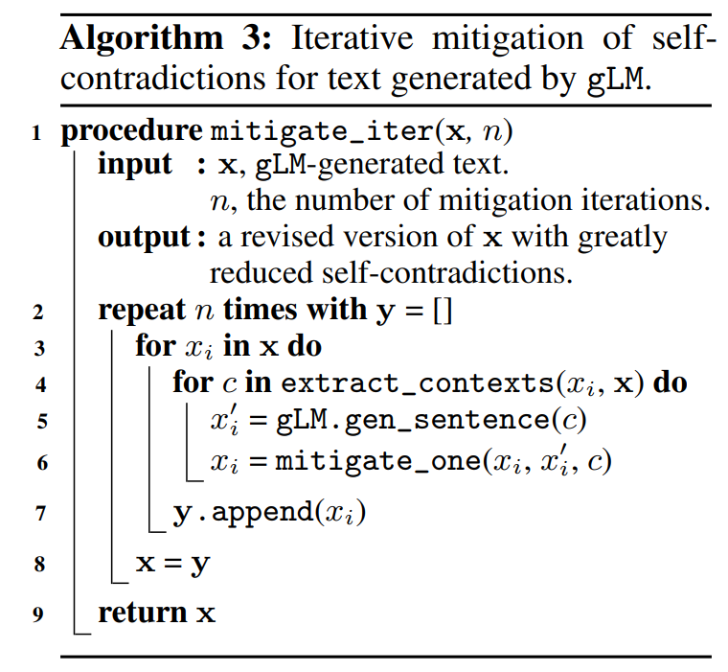
An iterative algorithm
Repeat the process for n times!!!

Slide 12
Experiment setup
Data: They sample 3 gLMs to generate encylopedic text descriptions for Wikipedia entities as MainTestSet which constists
360 descriptions
30 diverse entities
Models: GPT-4, GPT-3.5-turbo, Llama2-70B-Chat, Vicuna-13B
Manually label the ground truth of MainTestSet by three graduate students from reliable online resources

Slide 13
metrics
Trigger: the ratio of sentences for which at least one self-contradiction is triggered
Detection: classification precision, recall, and F1 score
Mitigation: the ratio of removed self-contradictions, informativeness (ratio of more sentences of true fact), and fluency (perplexity)

Slide 14
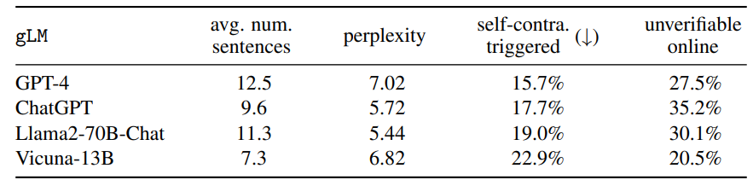
Results: trigger

Slide 15
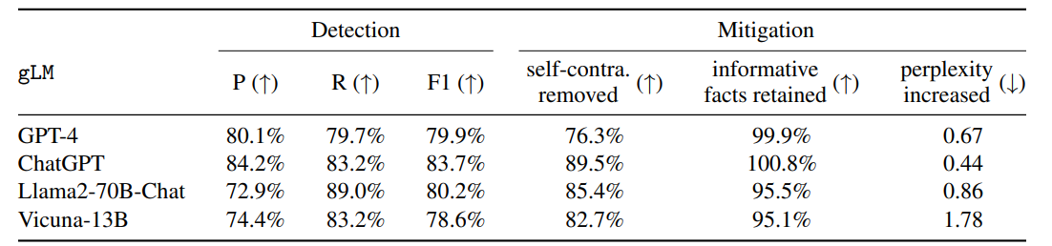
Results: detection & mitigation
Use the same aLM (ChatGPT) and different gLMs

Slide 16
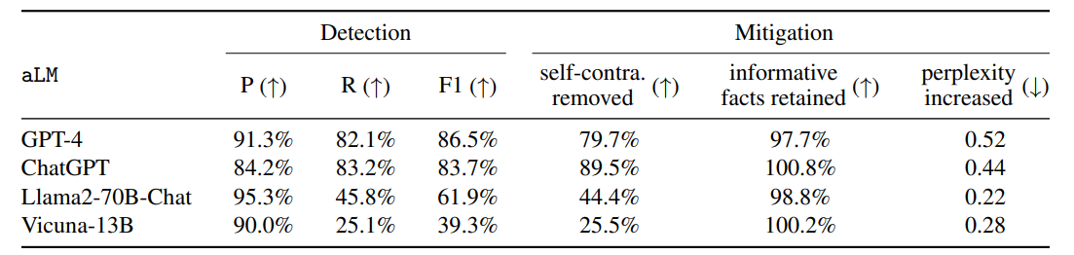
Results: detection & mitigation
Use the same gLM (ChatGPT) and different aLMs

Slide 17
Observations
1. The detection and mitigation methods are effective.
2. Performance varies across LMs.
3. Self-contradictions are significant!

Slide 18
Conclusion
The work comprehensively investigates self-contradiction.
They developed an algorithm to trigger, detect and mitigate self-contradictions.
The approach is based on prompting strategies, making it applicable to black-box LMs without requiring retrieval of external knowledge.
They build a user-friendly web: https://chatprotect.ai/

